Slide 1
EASYLEARN-
Platform for Online Courses…
Limitless learning guaranteed
Innovating learning processes.

Slide 2

Limitless learning guaranteed
Innovating learning processes.
PRESENTED
BY
Ahmad Abdulsalam a.
@CODELEARNERHUB

Slide 3
INTRODUCTION
E-learning refers to the use of various kinds of electronic media and information and communication technologies (ICT) in learning. E-learning is an inclusive terminology that encompasses all forms of educational technology that electronically or technologically support learning and teaching.
Depending on whether a particular aspect, component or delivery method is given emphasis, e-learning may be termed technology-enhanced learning (TEL), computer-based training (CBT), internet-based training (IBT), web-based training (WBT), online education, virtual education, or digital educational collaboration.
E-learning includes numerous types of media that deliver text, audio, images, animation, and streaming video, and includes technology applications and processes such as audio or video tape, satellite TV, CD-ROM, and computer-based learning, as well as local intranet/extranet and web-based learning.
E-LEARNING

Slide 4
WHAT IS e-LEARNING
(EASYLEARN)
“
A learning management system (LMS) or e-Learning (Electronic Learning) is a software application for the administration, documentation, tracking, reporting, automation, and delivery of educational courses, training programs, materials or learning and development programs.
“
quote
INTRODUCTION

Slide 5
PROBLEM STATEMENT

Slide 6
PROBLEM STATEMENT
01
User adoption
It can be difficult to encourage users to adopt and use the e-learning system, especially if they are accustomed to traditional learning methods
02
Content quality
The quality of the e-learning content, including accuracy, relevance, and engagement, can affect user satisfaction and retention.
03
Access and connectivity
Some users may not have reliable access to the internet or appropriate devices, which can limit their ability to use the e-learning system.
04
Access and connectivity
Some users may not have reliable access to the internet or appropriate devices, which can limit their ability to use the e-learning system.

Slide 7
Aims and Objective
To develop a platform that offers a wide variety of online courses to learners around the world.
05
01
To offer tools for instructors to create and manage their courses.
To create a user-friendly and intuitive platform that is easy to navigate and search.
To implement a secure payment system that supports multiple payment methods.
02
06
To provide a flexible and scalable platform that can accommodate a large number of courses and users.
07
To provide a personalized learning experience for student or anybody willing to learn new skills, including personalized progress tracking.
03
To reduce learning costs in E-Learning there are no papers, no delays, and no travelling expenses. Such learning enables employees to take what they have just learned from their computer screens and apply it to the tasks at hand.
04
08
To integrate social features that allow users to connect with other learners and instructors.

Slide 8
FUNCTIONAL REQUIREMENTS

Slide 9


FUNCTIONAL REQUIREMENTS
Payment system
A secure payment system that supports multiple payment methods.
Course creation and management
Learners or Students should be able to easily discover courses through search functionality, browsing categories, and personalized recommendations.
Learning tools
The platform should provide learners with a range of tools to support their learning, including quizzes and discussion forums.
Course creation and management
Analytics and reporting
Instructors should be able to easily create and manage their courses, including adding course materials, managing students, and tracking progress.
The platform should provide analytics and reporting features to enable instructors and administrators to track student progress, course performance, and other key metrics.

Slide 10
NON-FUNCTIONAL REQUIREMENTS

Slide 11
Non-functional requirements
01
Performance
The platform should be able to handle a large number of users and courses without experiencing significant slowdowns or downtime.
02
Usability
The platform should be intuitive and easy to use, with a clear and consistent user interface.
03
Security
The platform should be secure, with strong encryption for user data and payment information.
04
Scalability
The platform should be scalable to support a growing user base and increasing demand for courses.
05
Scalability
The platform should be scalable to support a growing user base and increasing demand for courses.

Slide 12
TECHNICAL REQUIREMENTS

Slide 13
TECHNICAL REQUIREMENTS
01
Server and hosting
The platform should be hosted on reliable and secure servers, with a scalable infrastructure to handle traffic and user demand.
02
Database management
The platform should have a robust database management system to store user data, course materials, and other important information.
03
Payment processing
The platform should integrate with a reliable and secure payment processing system to enable users to purchase courses.
04
Content management system
The platform should have a robust content management system to enable instructors to create and manage their courses.

Slide 14
ENTITIES
User
Enrolment
Including instructors and learners or Students
Represents a learner's enrolment in a course.
Category
Payment
A category or subject area for courses.
Represents payment made by a user for a course.
Course
Review
Represents a course created by an instructor.
Represents a learner's review of a course.
Lesson
Notification
This entity represents a lesson within a course.
Notification sent to users about course updates, messages, or other relevant information.

Slide 15
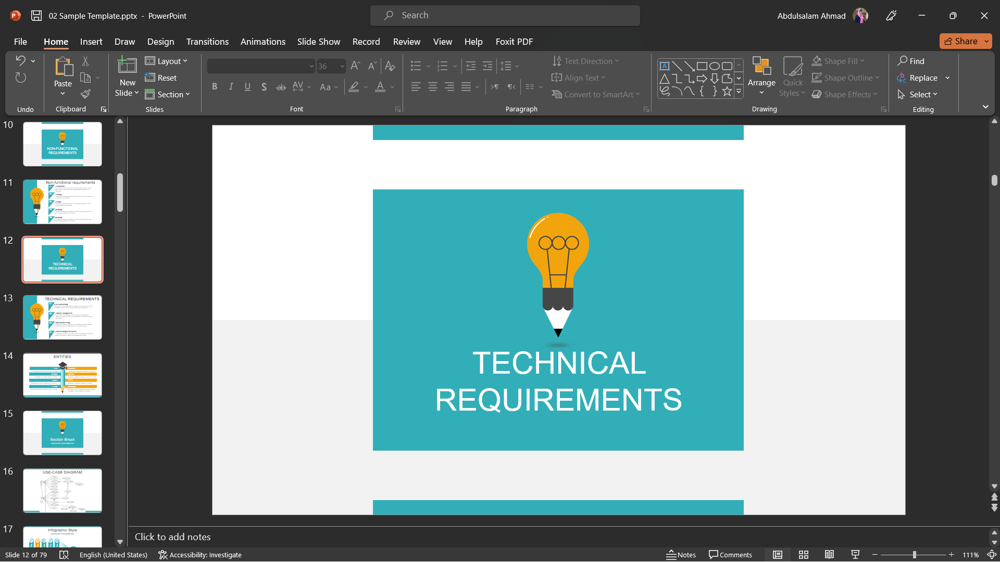
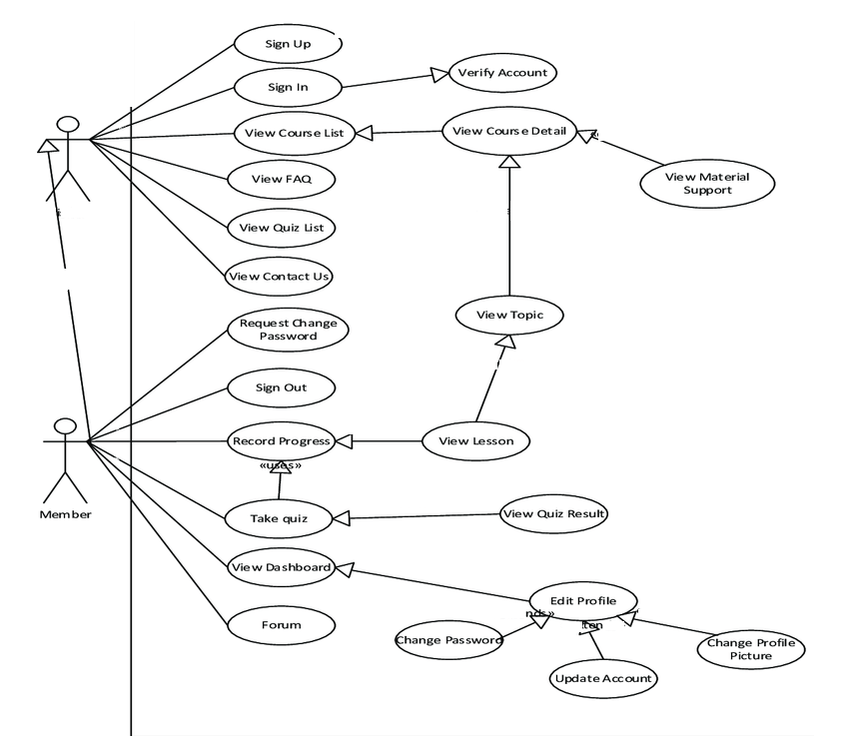
USE-CASE DIAGRAM
Unregistered User
Student

Slide 16
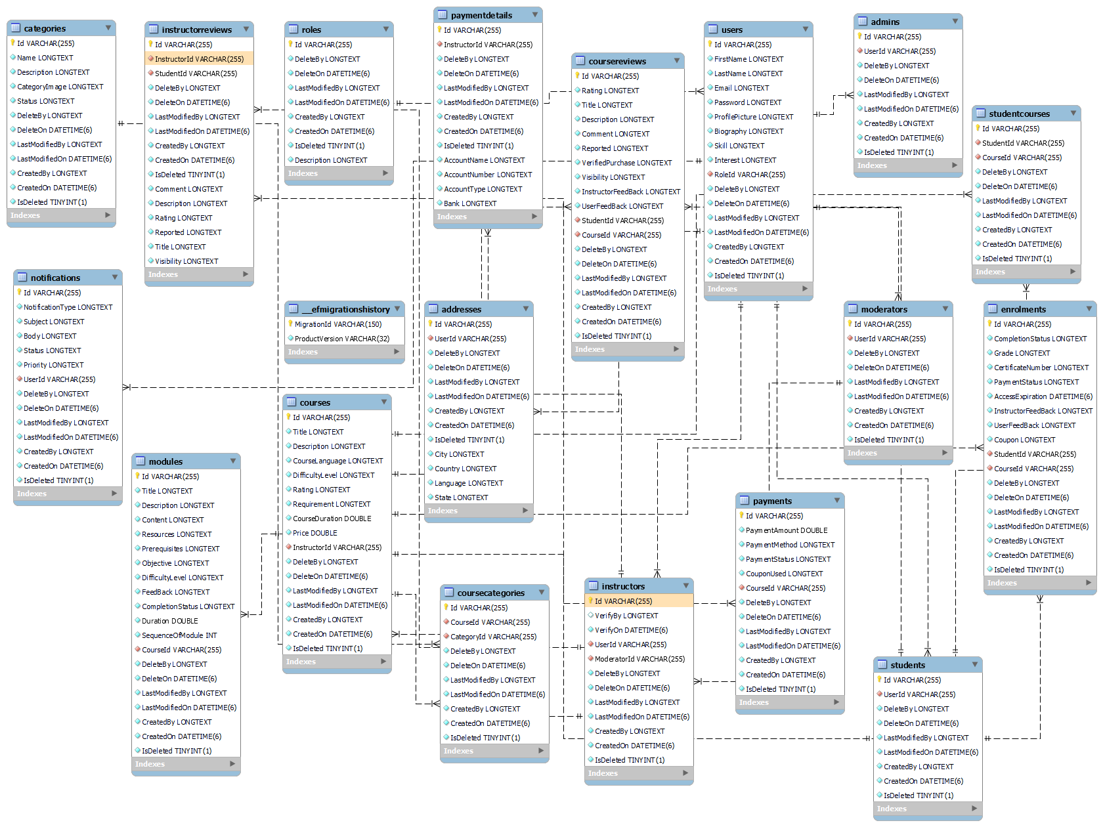

Slide 17
THANKS

